Slide 1
TURKISH STATISTICAL INSTITUTE
(TurkStat)
31.03.2014
(Muscat, Oman)

Slide 2
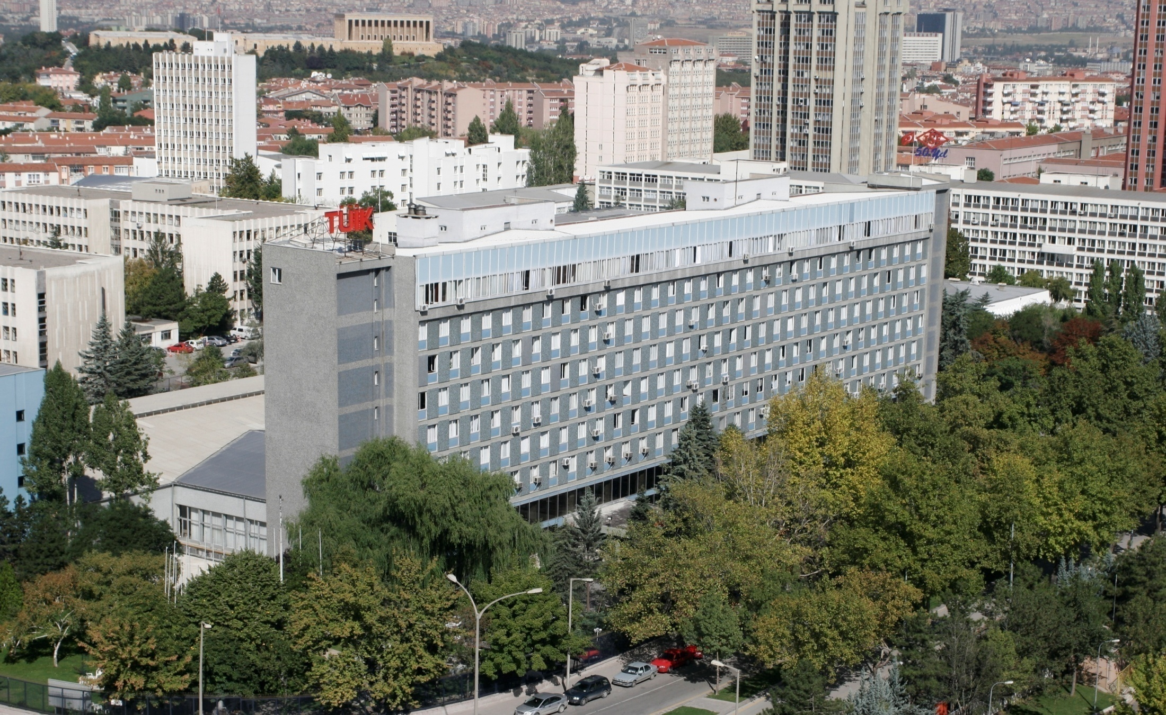
TURKISH STATISTICAL INSTITUTE

Slide 3
OUR MISSION
“To produce and disseminate statistics
which are qualified, timely, reliable, objective and consistent with the international standards, respond to the requirements and priorities of national and international users, and to provide co-ordination between the public institutions involved in the production process of official statistics.”

Slide 4
Organizational Structure of TurkStat
Turkish Statistical
Institute
Official
Statistics
Programme
Presidency
of TurkStat
Statistical Council
Advisory Board
Central Organization
Managing the Turkish Statistical System
Planning
Coordination
Methodological Studies
Analysing
Processing
Dissemination
Regional Offices (26)
Data Collection
Data Control

Slide 5
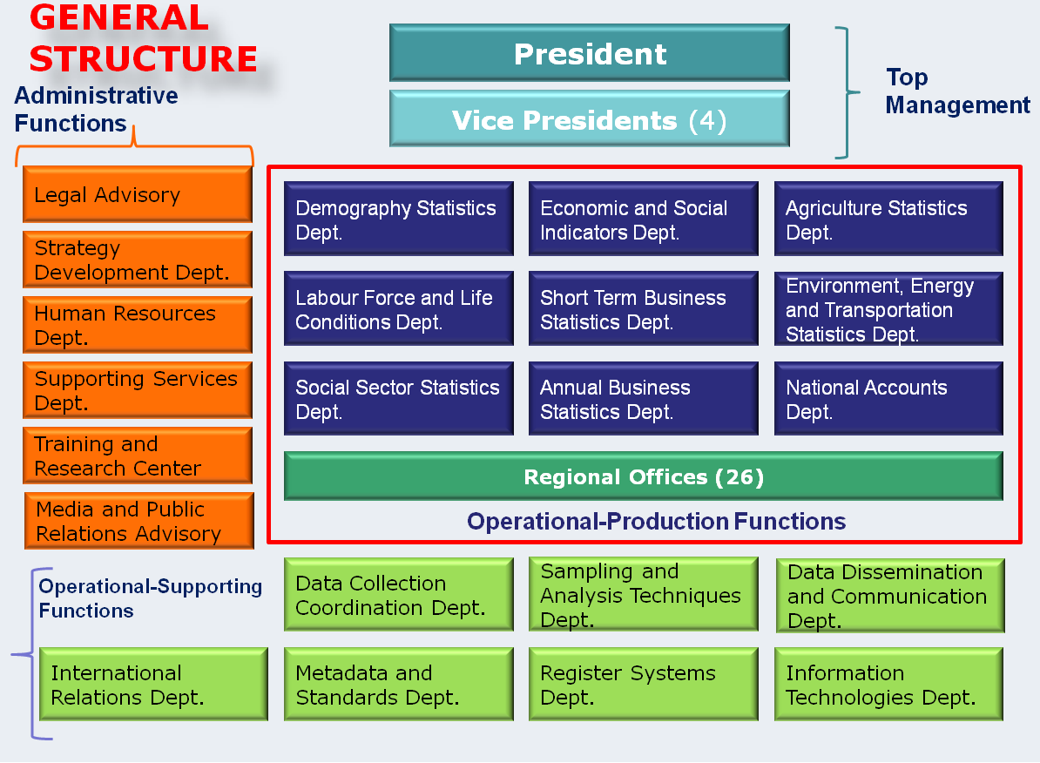

Slide 6
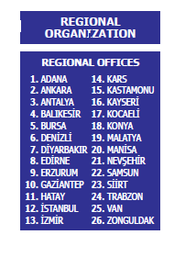
Tasks of Regional Offices
compilation, assessment, quality control, analysis and transfer of the data produced by census and research activities held at national level to the central organization,
forming the infrastructure of the data at regional level and its production.
Reports directly to the President
Surveys are done for collecting data

Slide 7
Human Resources
Status of staff (Number)
Status * | Total | Central Organization | Regional Offices
Permanent | 1 685 | 838 | 847
Temporary | 1 758 | 143 | 1 615
Other (Worker) | 35 | 35 | -
Total | 3 479 | 1 015 | 2 464
%66 Technical, %7 Administrative, %27 Other
%91 University graduated, %19 is master/ph degree
* As of 01/07/2013

Slide 8



How do we produce statistics?

Slide 9


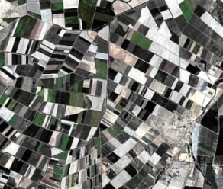

Compilation of Data
By Using Administrative Records
Data entry by using the received forms
Online data transmission
By Using Questionnairre
Interviewing
Mailing
Web-Based Questionnairre
Computer Assisted Personal Interview (CAPI)
CATI - Computer Assisted Telephone Interview (Data Quality Control Studies)
Paper based

Slide 10
Official Statistics Programme
(2012-2016)
Consists of 6 main items and 40 sub-items
Statistical Infrastructure
Social and Demographic Statistics
Macroeconomic statistics
Business Statistics
Agriculture Statistics
Environment Statistics
287 official statistics
Metadata (data of data)

Slide 11
Principles of Publication and Dissemination
Equal and easy accessibility
User oriented and user friendly
Impartiality
Transparency
Timeliness
Confidentiality of data

Slide 12
Fundamental Principles of Official Statistics
given by UNECE
(United Nations Economic Commission for Europe
Relevance, impartiality and equal access
Professional standards and ethics
Accountability and transparency
Prevention of misuse
Sources of official statistics
Confidentiality
Legislation
National coordination
Use of international standards
International cooperation
References:
http://www.unece.org/stats/archive/docs.fp.e.html (principles)
http://www.unece.org/stats/documents/writing/ (making data meaningful guide

Slide 13
Distribution Types
Press Release
Distribution Channels
Directly to the persons
Publication
Brochure
Unpublished Stock Information
Individual data
Database
By fax
By mail
By e-mail
Web site
By phone (Information Channel)
Teletext
SMS (mobile phone)
By cargo

Slide 14
Press releases/publications disseminated in the context of OSP by years
Press release/publications | 2008 | 2009 | 2010 | 2011 | 2012
Daily | 753 | 759 | 747 | 758 | 787
Weekly | 364 | 416 | 414 | 467 | 467
Monthly | 696 | 756 | 764 | 759 | 801
Quarterly | 120 | 136 | 164 | 152 | 166
Biannually | 4 | 8 | 10 | 4 | 7
Annuallly | 196 | 151 | 152 | 145 | 175
Total | 2133 | 2226 | 2251 | 2285 | 2403
Notes:
14

Slide 15
User Groups | Number | %
Individual Users | 2 181 | 33,5
Private company/institute | 1 488 | 22,9
Public organization/institute | 1 433 | 22,0
Universities | 514 | 7,9
Judgement organizations | 256 | 3,9
Corporations/donations | 173 | 2,7
Local Governance | 111 | 1,7
International Associations | 99 | 1,5
Chambers of Industry | 77 | 1,2
Media | 51 | 0,8
Ambassadorships | 40 | 0,6
Labour Unions | 36 | 0,6
Educational Institutes | 8 | 0,1
Political Parties | 4 | 0,1
Others | 36 | 0,6
(*) 2011

Slide 16



Internet web site is the main dissemination channel www.turkstat.gov.tr
1200 tables and 60 interactive dissemination database
Metadata
Classification server

